Slide 1
Prediction for Getting Heart Disease Using Logistic Regression Model
Data Science Project
By Shahad Alalmaee

Slide 2
Since heart disease can be hard to detect in early stage, we need to find a way to predict this disease earlier.
In this project I will use Logistic Regression Model to predict heart disease that can assist medical professionals in predicting heart disease status based on the clinical data of patients.

Slide 3
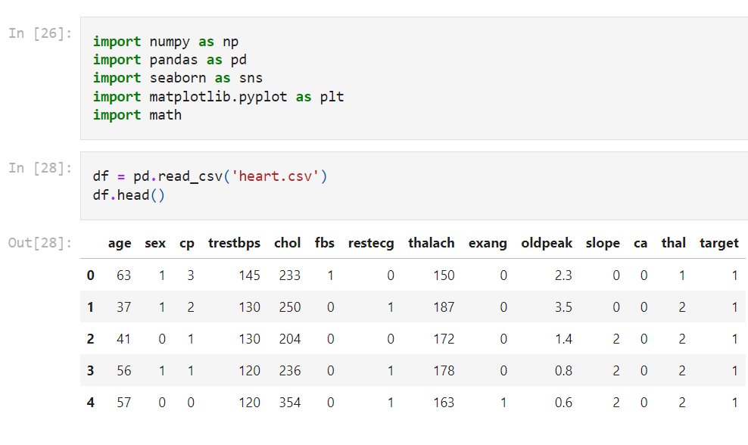
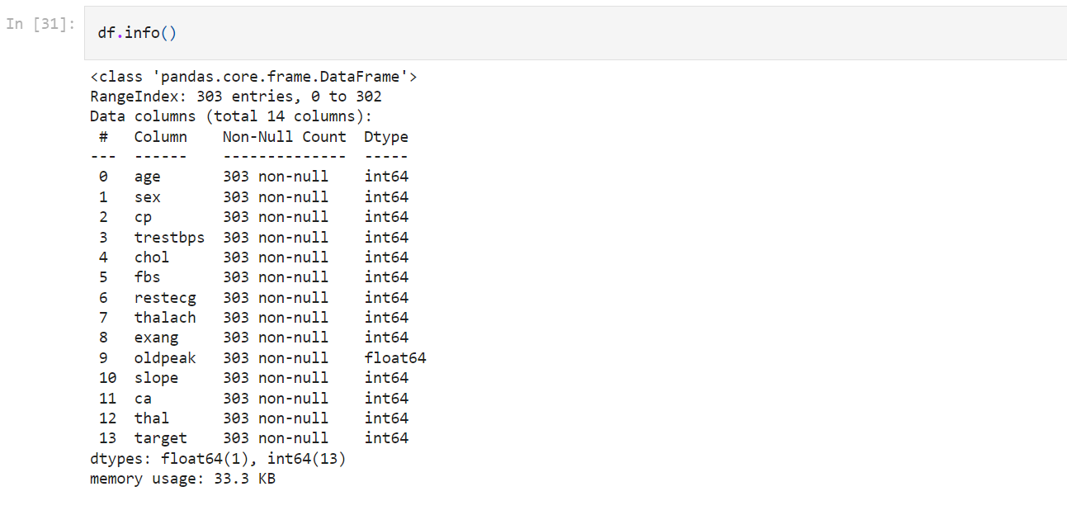
The dataset I will be using hosted on Kaggle and it was from UCI Machine Learning Repository

Slide 4
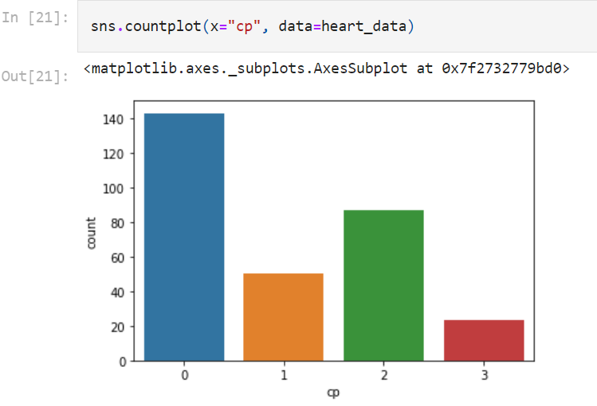
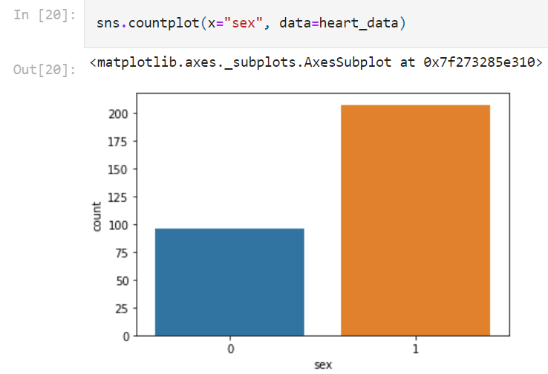
Work and Visualization
Chest pain type
Value 0: asymptomatic
Value 1: atypical angina
Value 2: pain without relation to angina
Value 3: typical angina
The description of the data doesn't provide information about how this classification of pain was made. But we can see that it is very difficult to tell whether a patient has a heart disease attending just to the symptoms of the patients.
Value 0: female
Value 1: male
sex is a risk factor
men are more likely to have a heart disease than women.

Slide 5
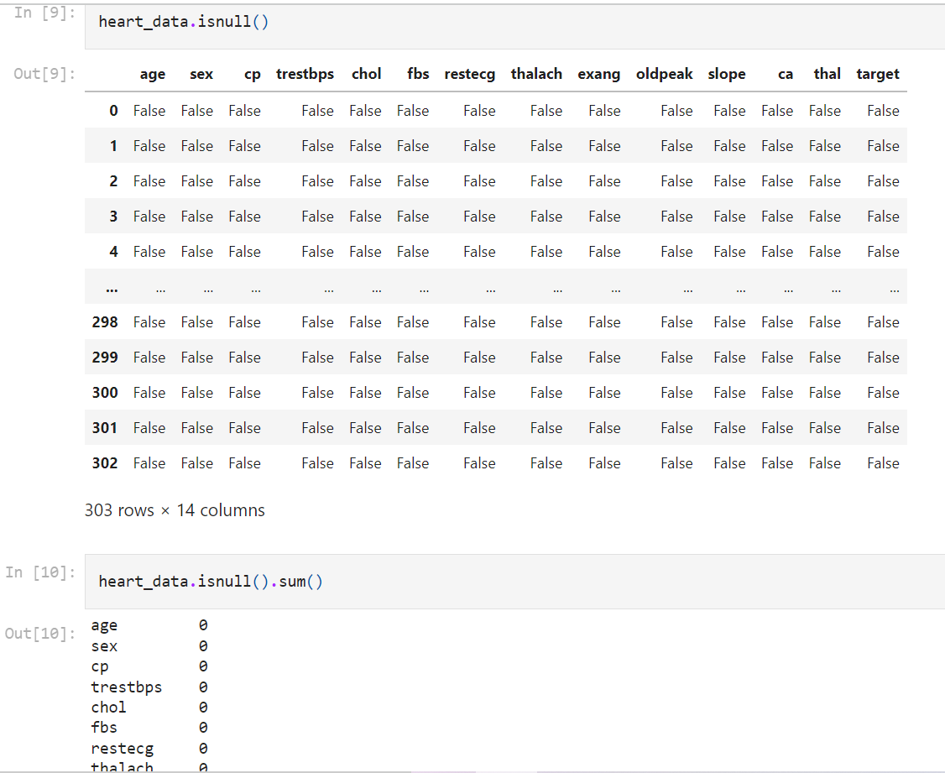
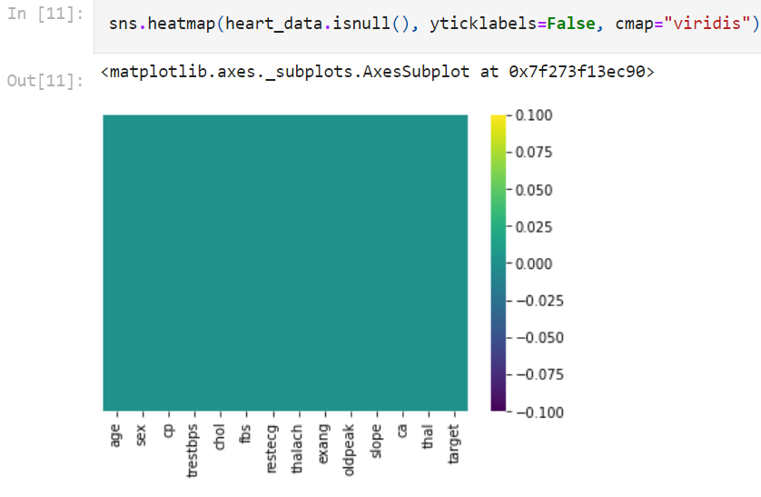
Check Missing Values

Slide 6
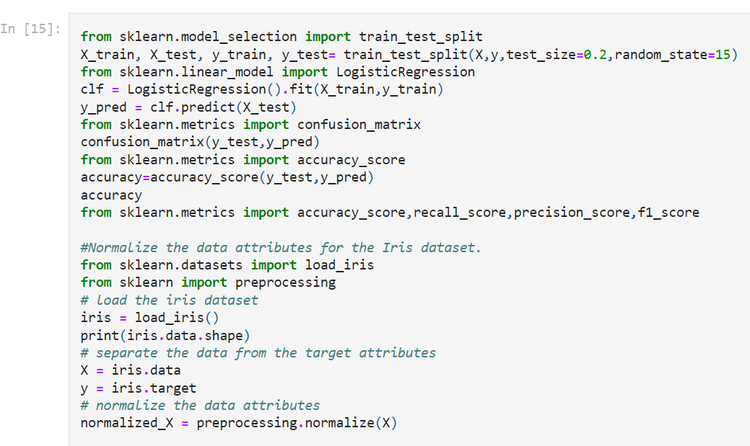
Train and Test

Slide 7
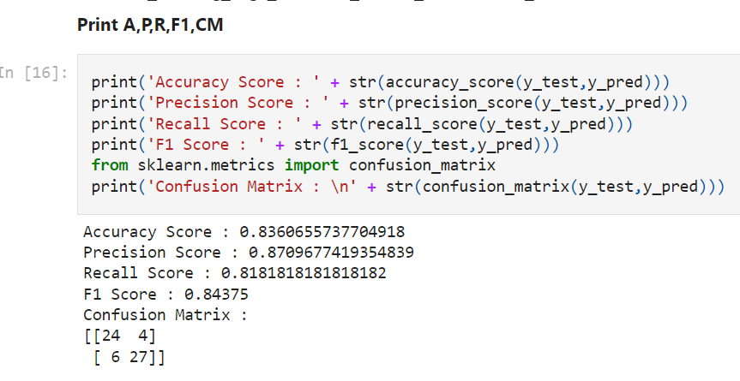
Accuracy Result

Slide 8
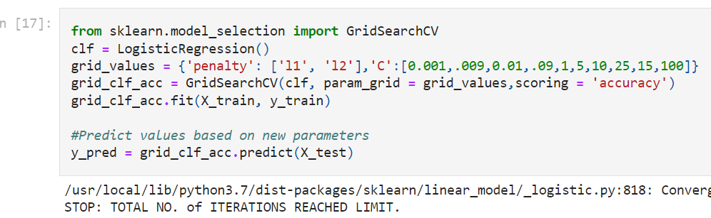
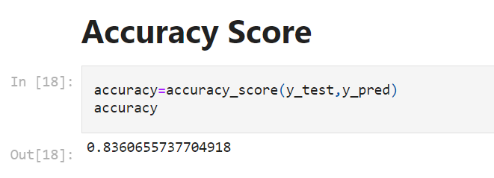
Improve the Accuracy

Slide 9
Conclusion
This project will provide better diagnosis the heart patients. I used here Logistic Regression Model to predict heart disease that can assist medical professionals in predicting heart disease status based on the clinical data of patients and I got a really good accuracy score.
First, we select 14 important clinical features from the dataset then using the Model to predict the disease depending on the target feature.
Finally we got the accuracy score and the Confusion Matrix

Slide 10
Thank You !

